Slide 1
Lab Reopening Strategies
Mariano Rubio
Citrus College

Slide 2
Where are we at so far?
We’ve been thrust into a new paradigm!
Getting knowledgeable with on-line resources
So now what?
Are we going to stay in an on-line instructional format?
If so, there are great resources and curriculum available!
Most programs will still need to strategize how to reopen labs, even if partially!

Slide 3
Strategies for Reopening Labs
Integrating newfound resources into our traditional lecture/lab curriculum
Establishing lab environment protocols
Establishing screening procedures & schedules for students
Determining PPE protocols
Determining cleaning/disinfecting supplies needed
Establishing process for cleaning tools and common touch points on vehicles and equipment

Slide 4
Safety First!
Before students enter lab, it may be a good idea to devote some lecture time to safety and new shop protocols.
Consider developing a labsheet that allows the students to view things like COVID-19 CDC recommendations and your own shop COVID procedures.
Just as training on safe vehicle lifting or tool use techniques are important, training on pandemic guidelines for the shop are equally as important.

Slide 5
Integrating New Resources into Instruction
Supplemental instructional resources:
On-line supplemental content
Integrating augmented or virtual reality instruction
Traditional Instruction may be changed forever!
VR example - TRANSFRVR - https://www.youtube.com/watch?v=rVbbgSrThTs

Slide 6
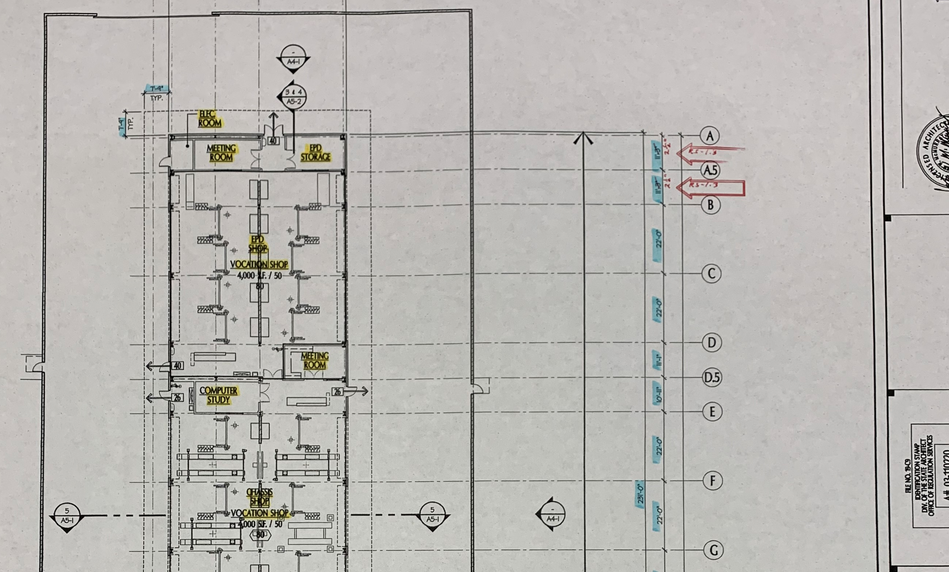
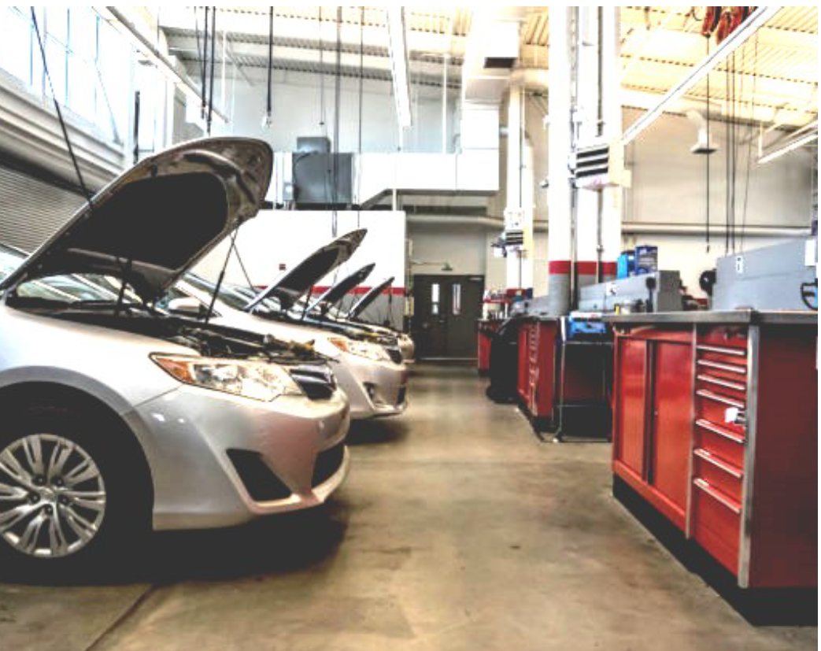
Lab Environment Protocols
Looking at our floor plans:
Will we need to add barriers?
Can we space out the vehicles?
How far apart are the toolboxes?
Can we add barriers?
How far apart are the vehicles?

Slide 7
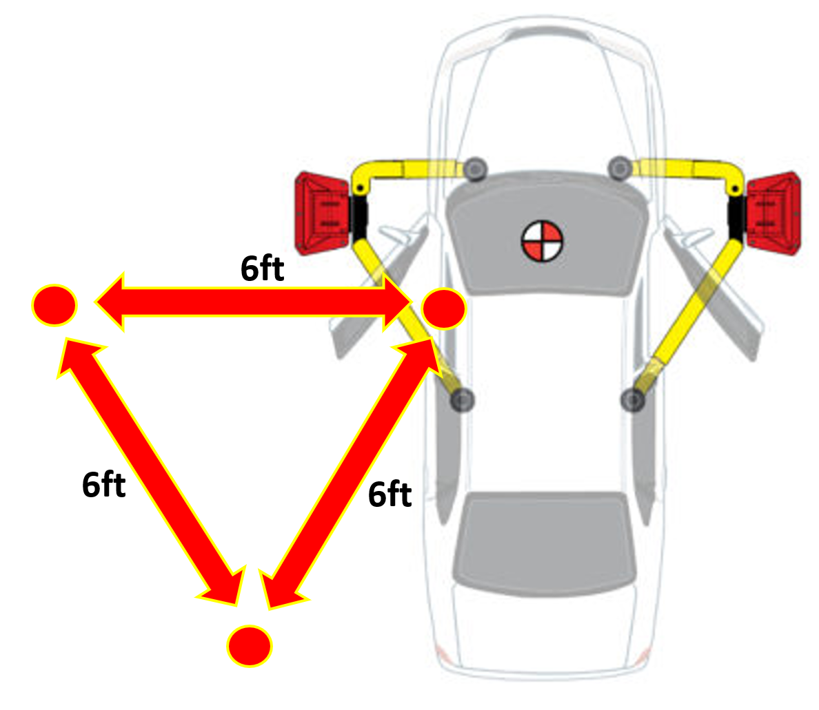
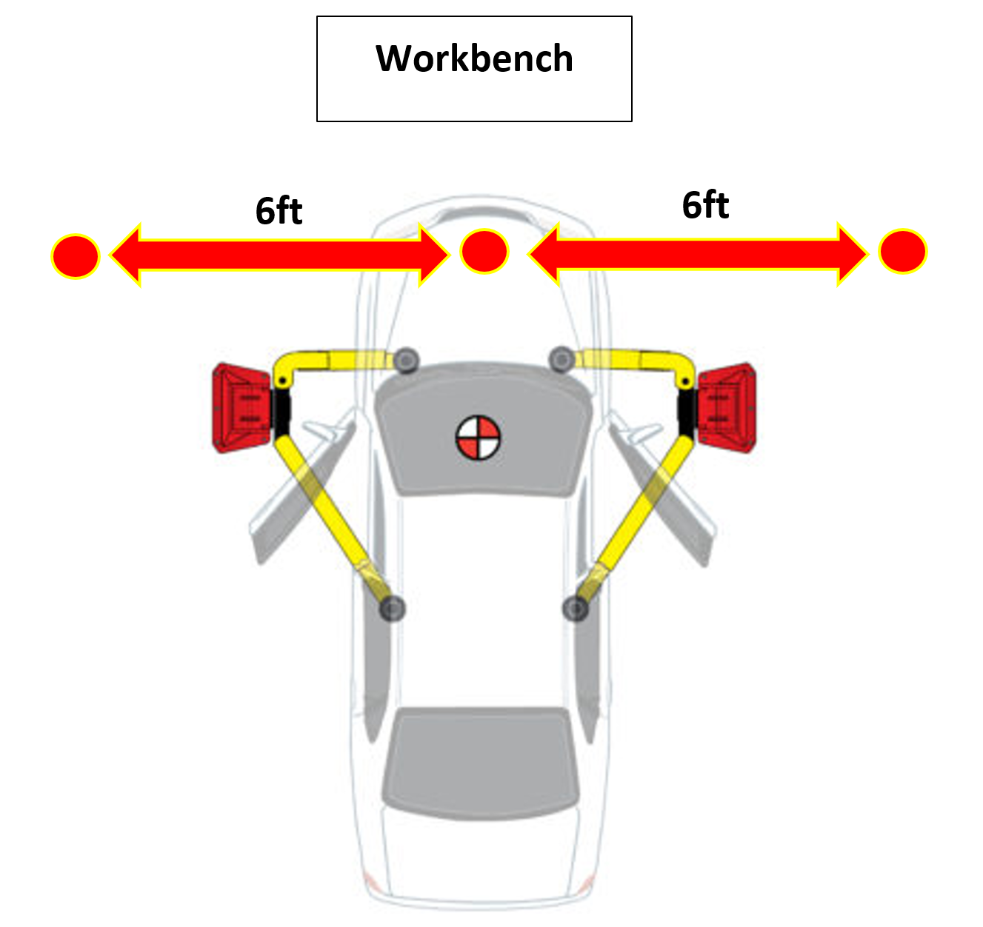
Lab Environment Protocols
Moving students around vehicles:
Task performed from driver’s seat: 3 students
Task performed under the hood: 3 students

Slide 8
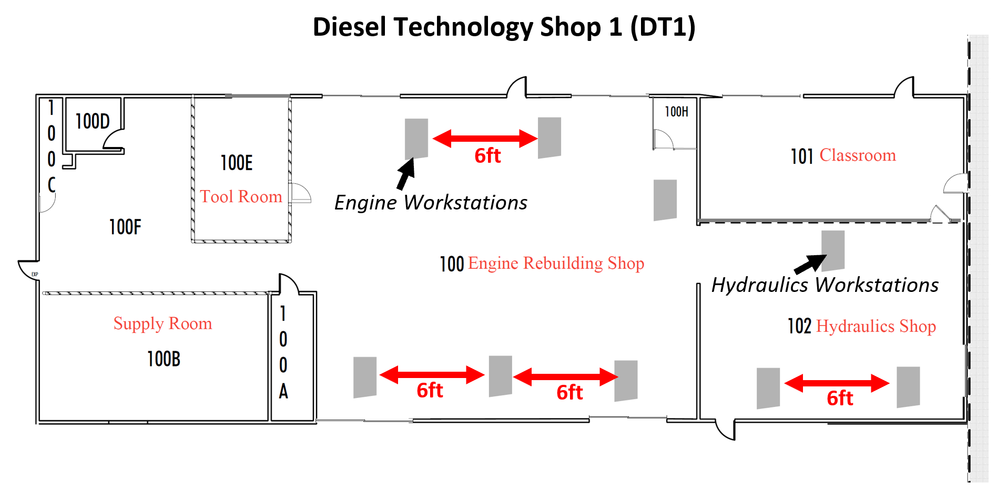
Lab Environment Protocols
Moving workstations around:

Slide 9
Screening Procedure for Students
Having students sign a laboratory process acknowledgement
Pre-screening questionnaire w/temperature measurement (Will this be handled by campus safety?)
Limiting items entering the lab area
Acknowledgment by student of required PPE
Establishing a written guide for students for lab and collegewide practices

Slide 10
Protocol for Students in Lab
Lab Procedures
2 person teams (3 if space allows)
Lab time: 4 – 8hrs for two meetings/week
Students take breaks at the same time
Instructor able to assist each team
Determine if the school will allow eating on-campus or off-campus
Set up lab make-up times for missed Spring or Summer lab content

Slide 11
Protocol for Students in Lab
Lab Procedures
Students on-site only to complete lab exercises
Students leave immediately when lab assignment complete
Alert students not congregate in any space on campus, including parking lots
Remind students that threat of spreading the virus is still real and can occur anywhere
Students will be responsible for cleaning tools, vehicles and equipment!
More on that later.

Slide 12
Lab Environment Protocols
Face masks should always be worn prior to entry and while in the facility.
Students and instructors should follow the CDC 6ft recommendation.
Students should wear gloves and properly remove and dispose of them as per CDC guidelines.
If a student starts feeling sick, they must be separated from others and follow your school’s lab safety procedures.

Slide 13
Lab Environment Protocols
Proper hand washing techniques should be followed (20 second rule).
If using hand sanitizer, make sure it contains at least 60% alcohol.
Remember to remove gloves without touching the outside of the glove with fingers.

Slide 14
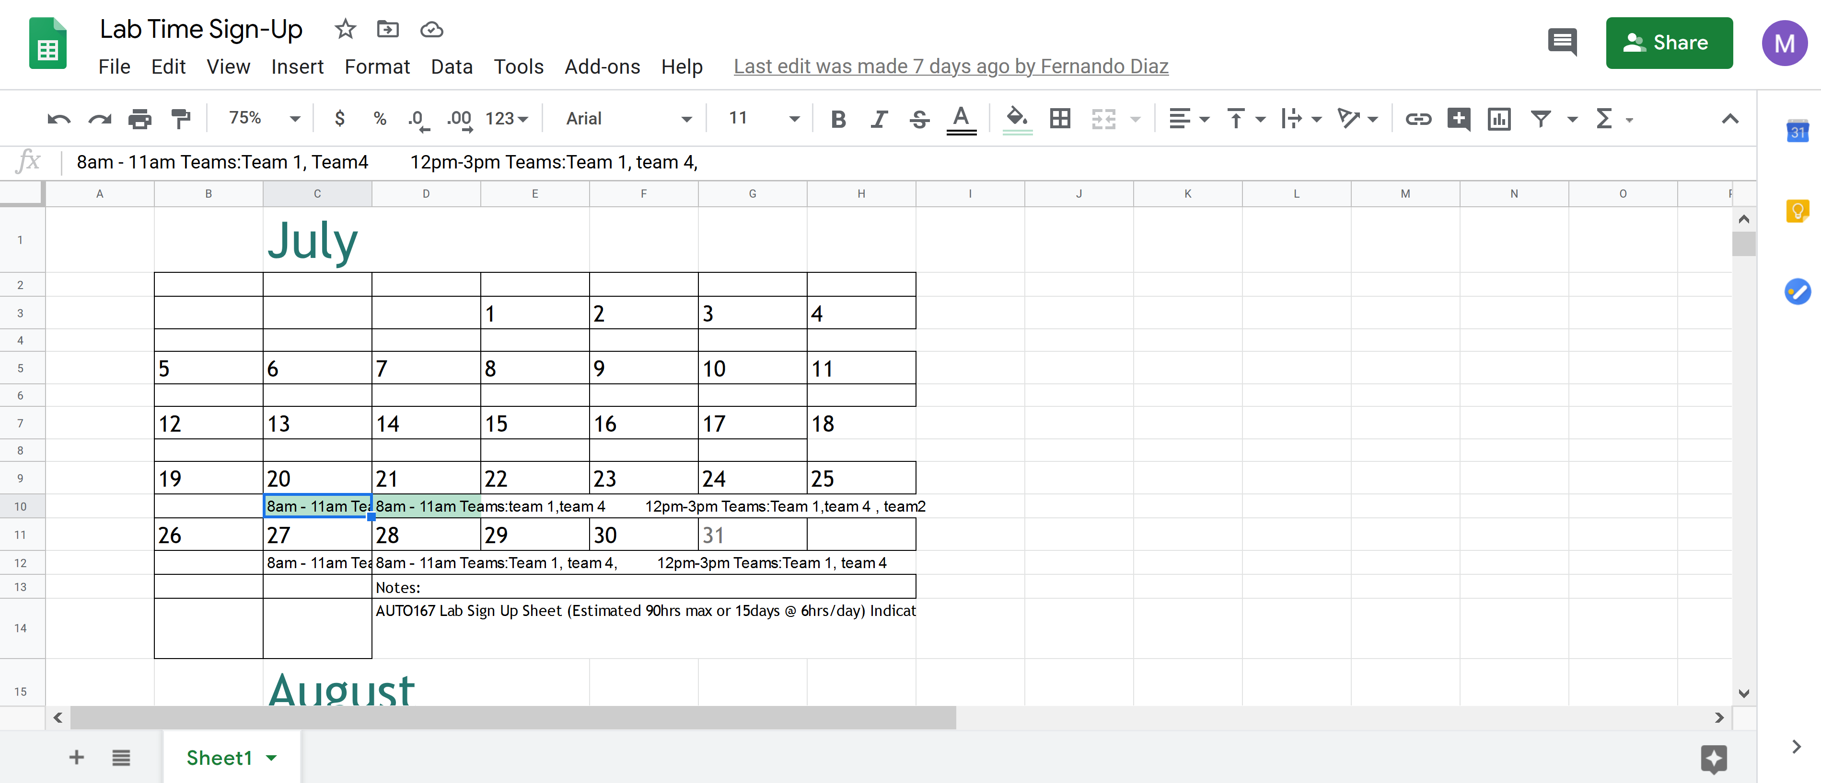
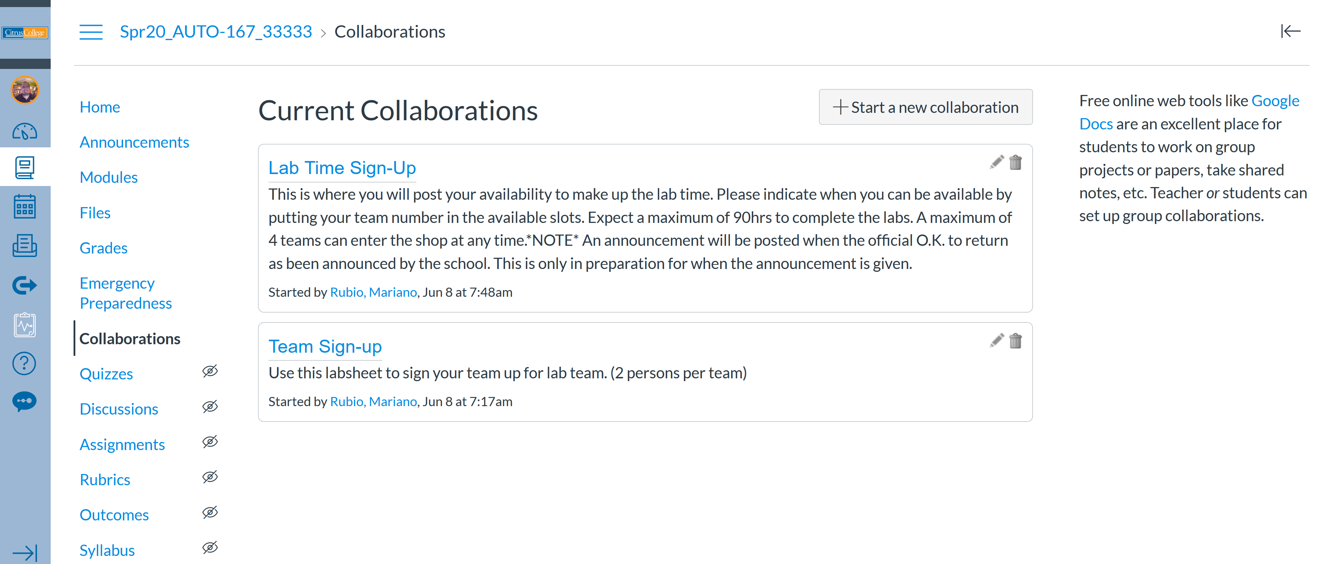
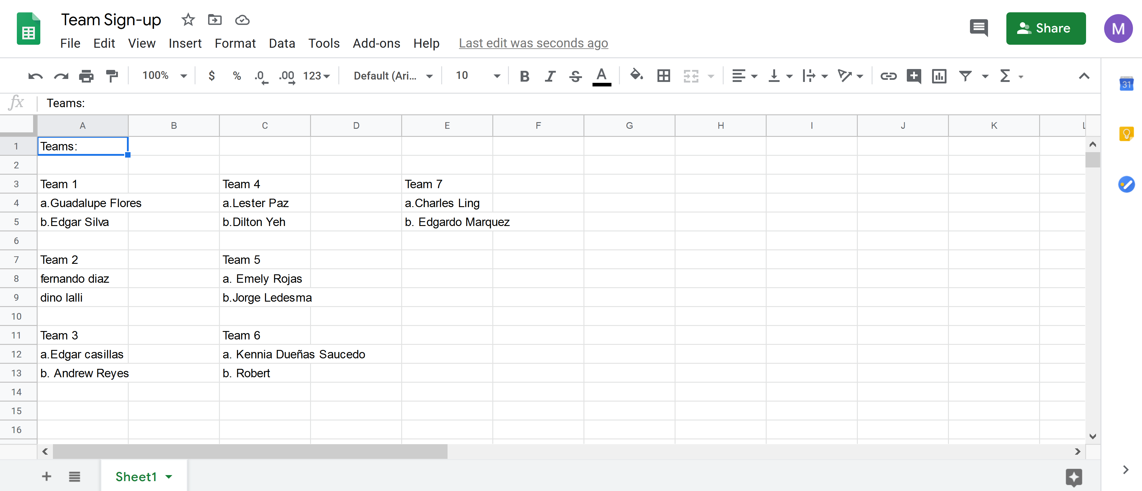
Establishing Student Rotation Schedule

Slide 15
PPE Protection Guidelines
Face coverings
Gloves
Safety glasses
Face shields
6-foot distancing
https://www.cdc.gov/coronavirus/2019-ncov/community/colleges-universities/index.html

Slide 16
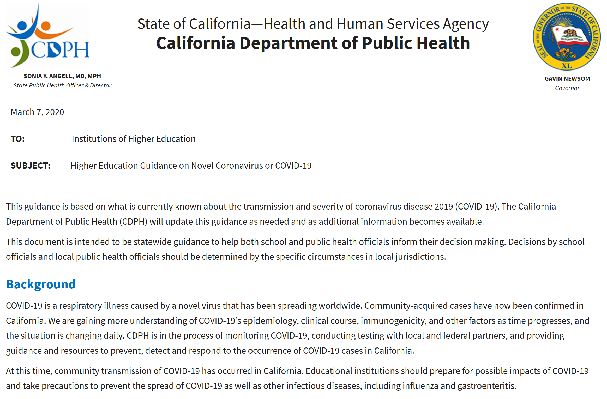
PPE Protection Guidelines
California Specific Guidelines
Guidance in case students or faculty get sick
https://www.cdph.ca.gov/Programs/CID/DCDC/Pages/COVID-19/HigherEducationGuidanceonNovelCoronavirusorCOVID19.aspx

Slide 17
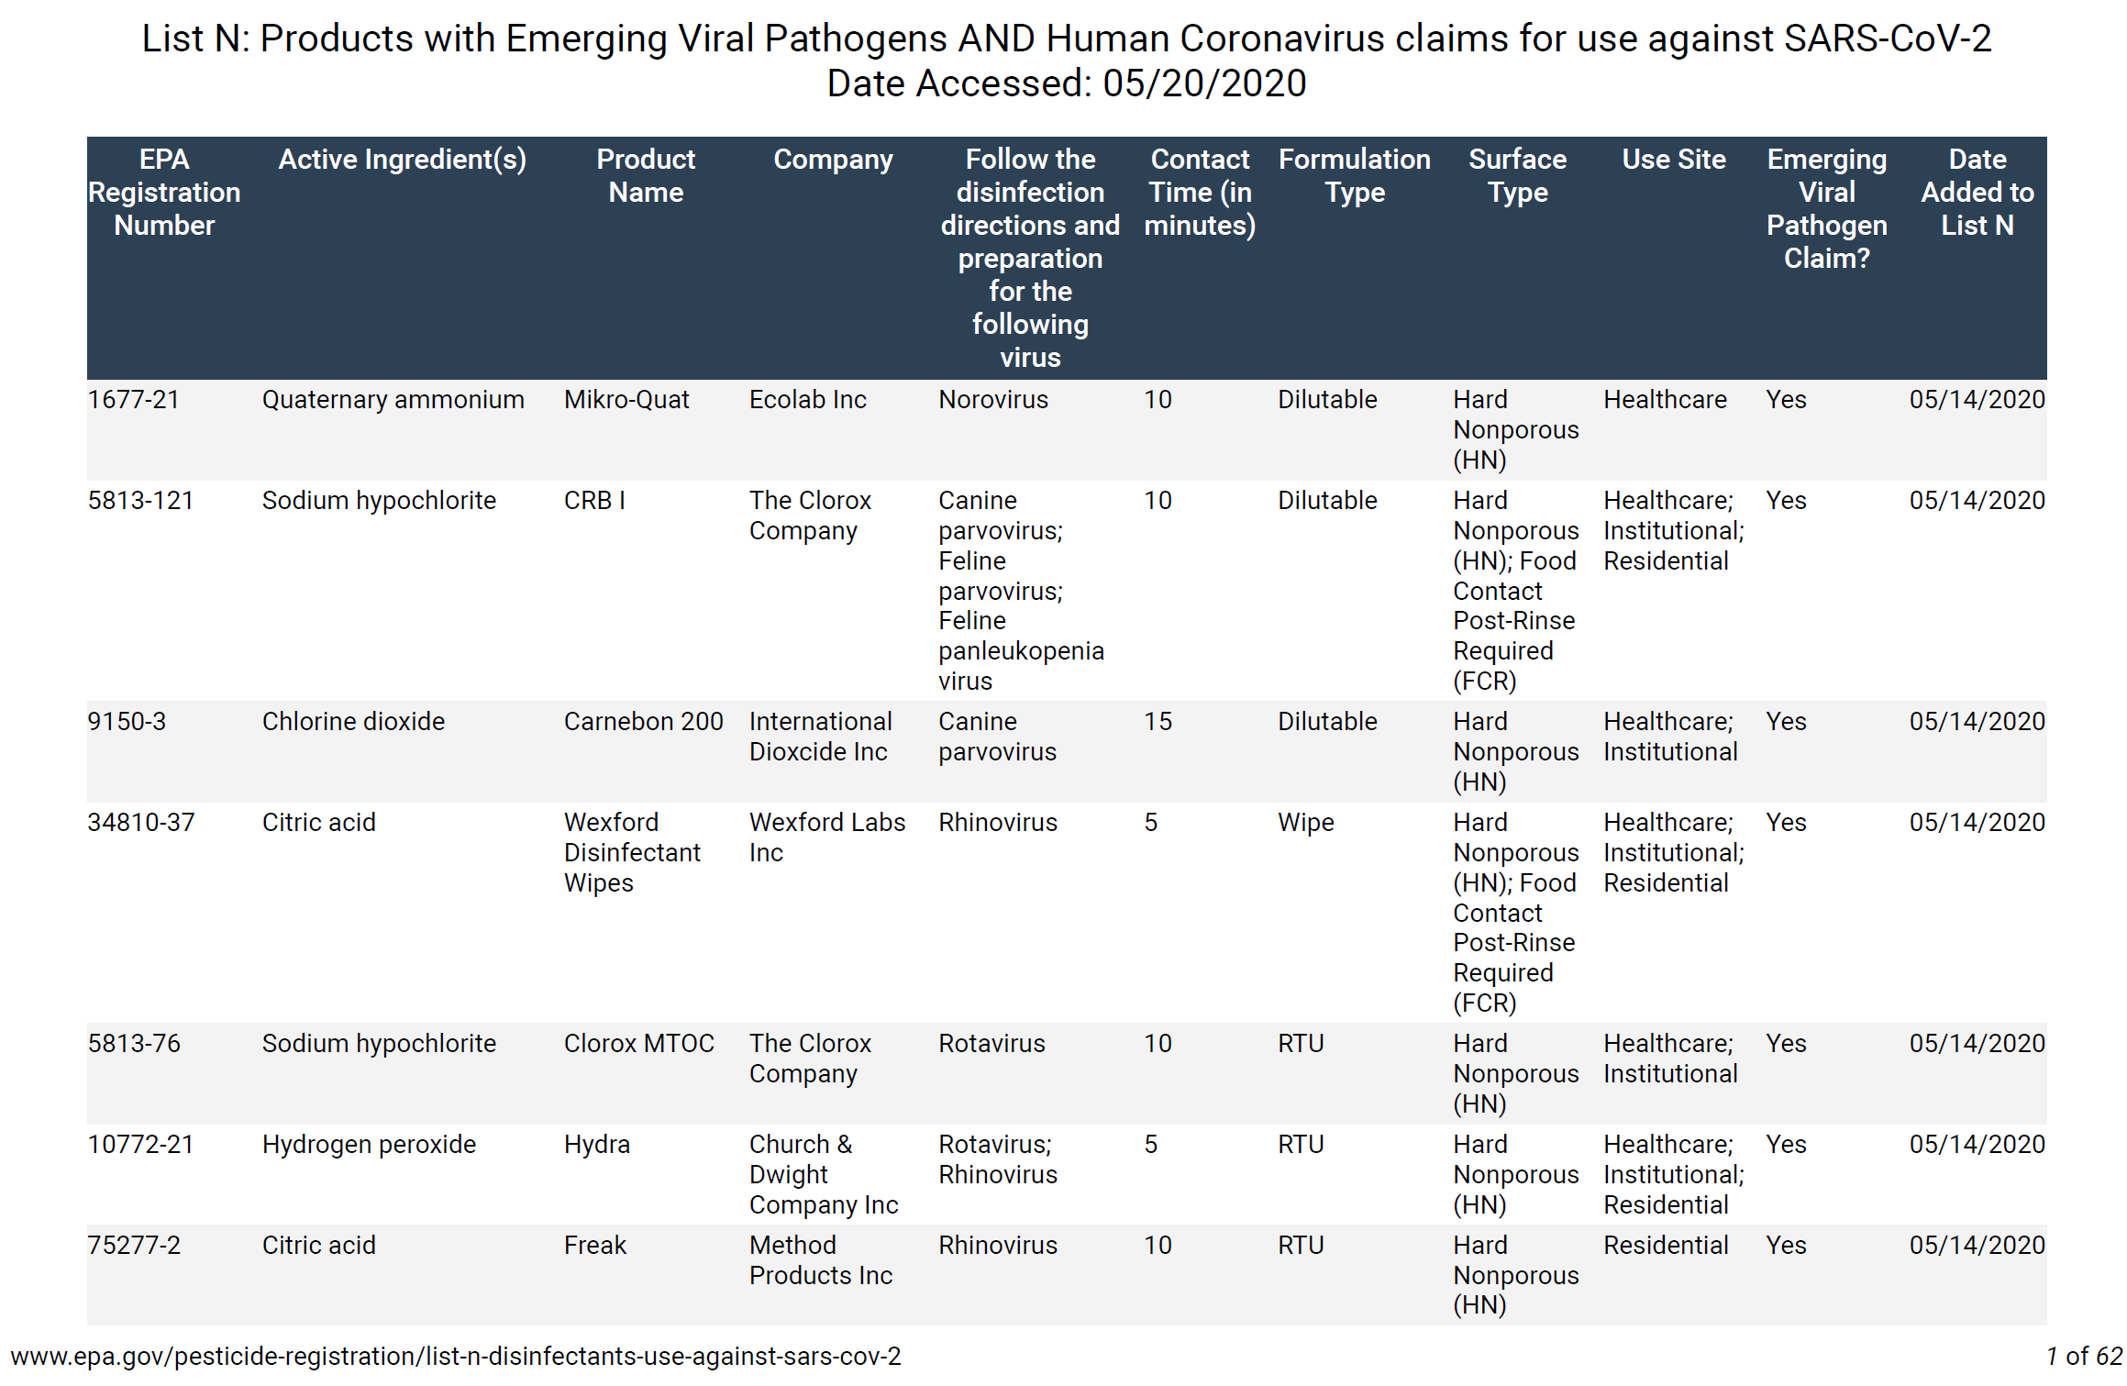
Cleaning/Disinfectant Supplies
Lab/Tool/Equipment cleaning supplies
Recommended supplies can be found on CDC website
https://www.cdc.gov/coronavirus/2019-ncov/community/disinfecting-building-facility.html

Slide 18
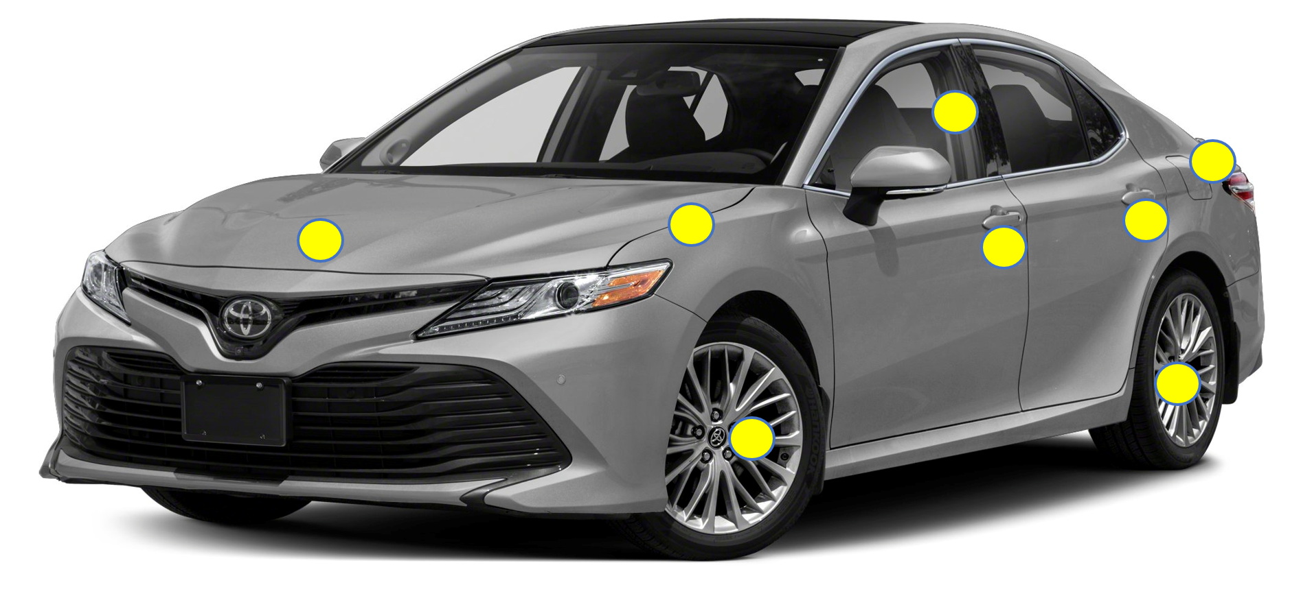
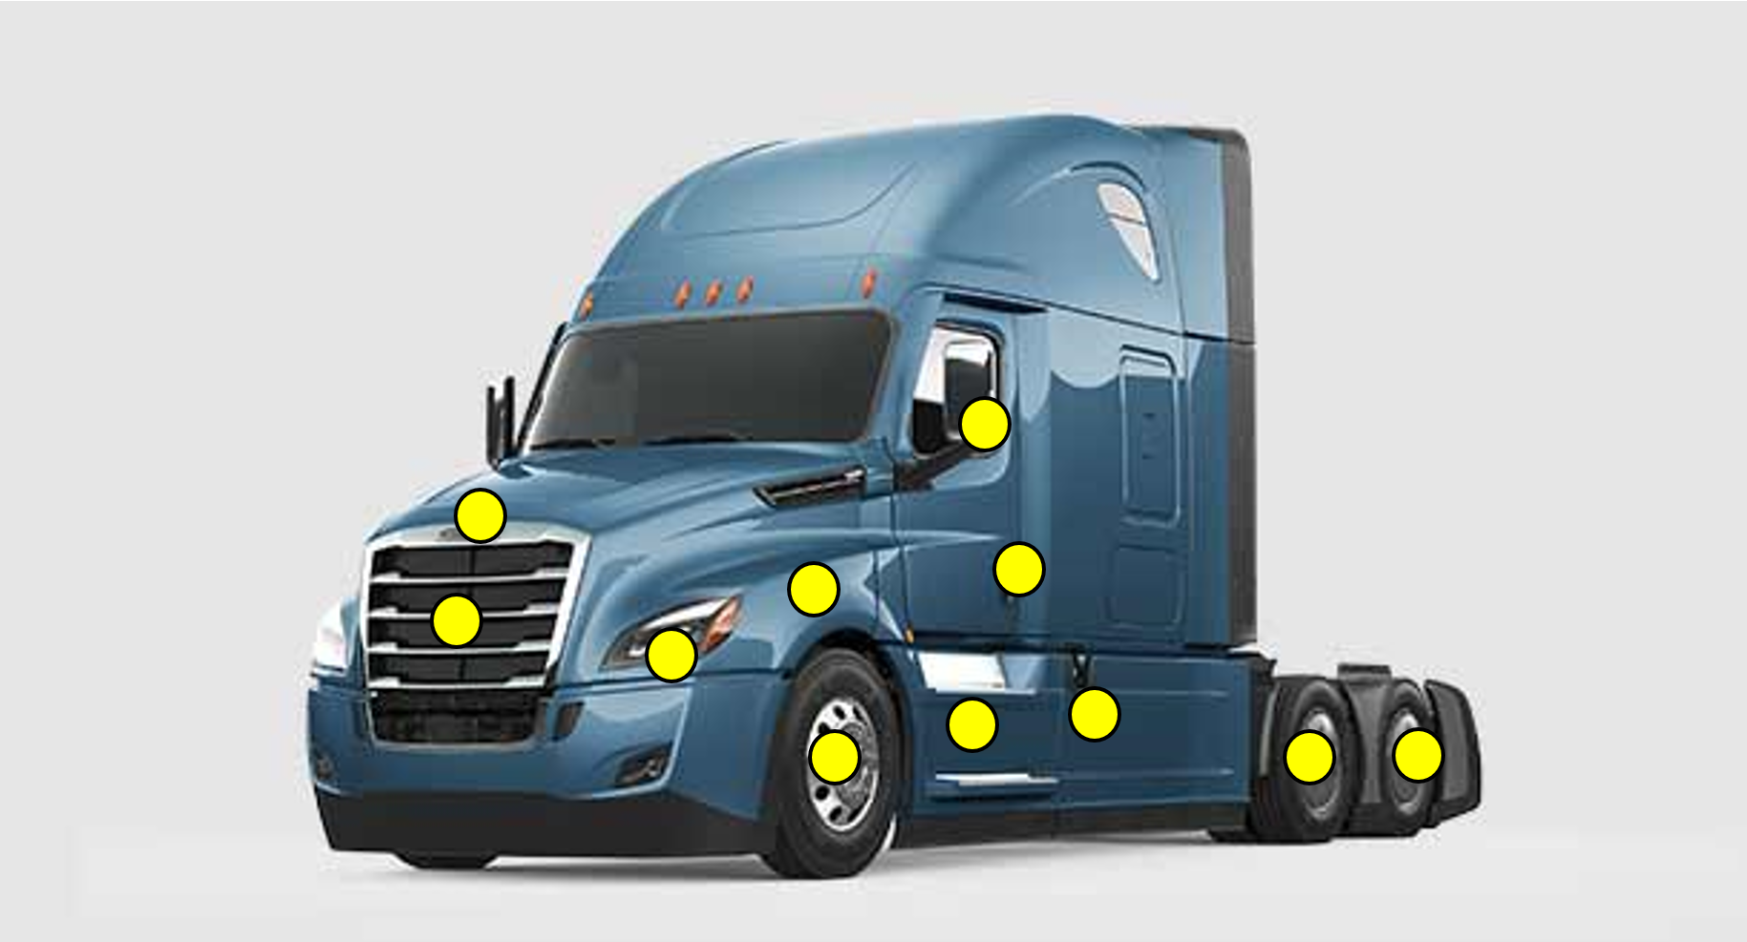
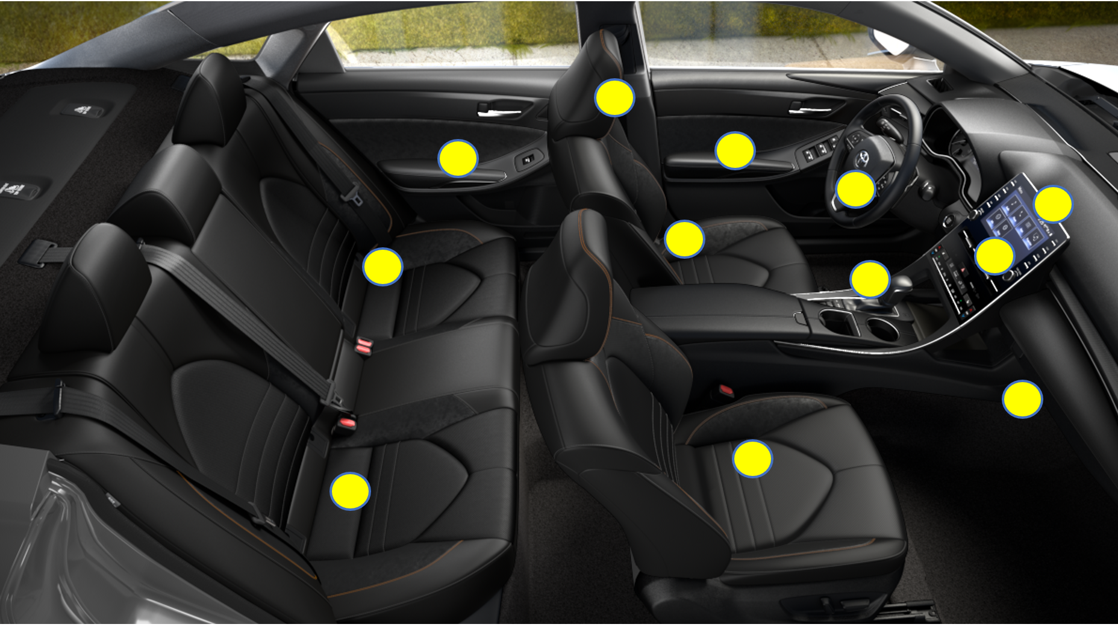
Wiping Down Vehicles and Equipment
Common touchpoints on vehicles will need to be considered
Instruct students on proper cleaning techniques

Slide 19
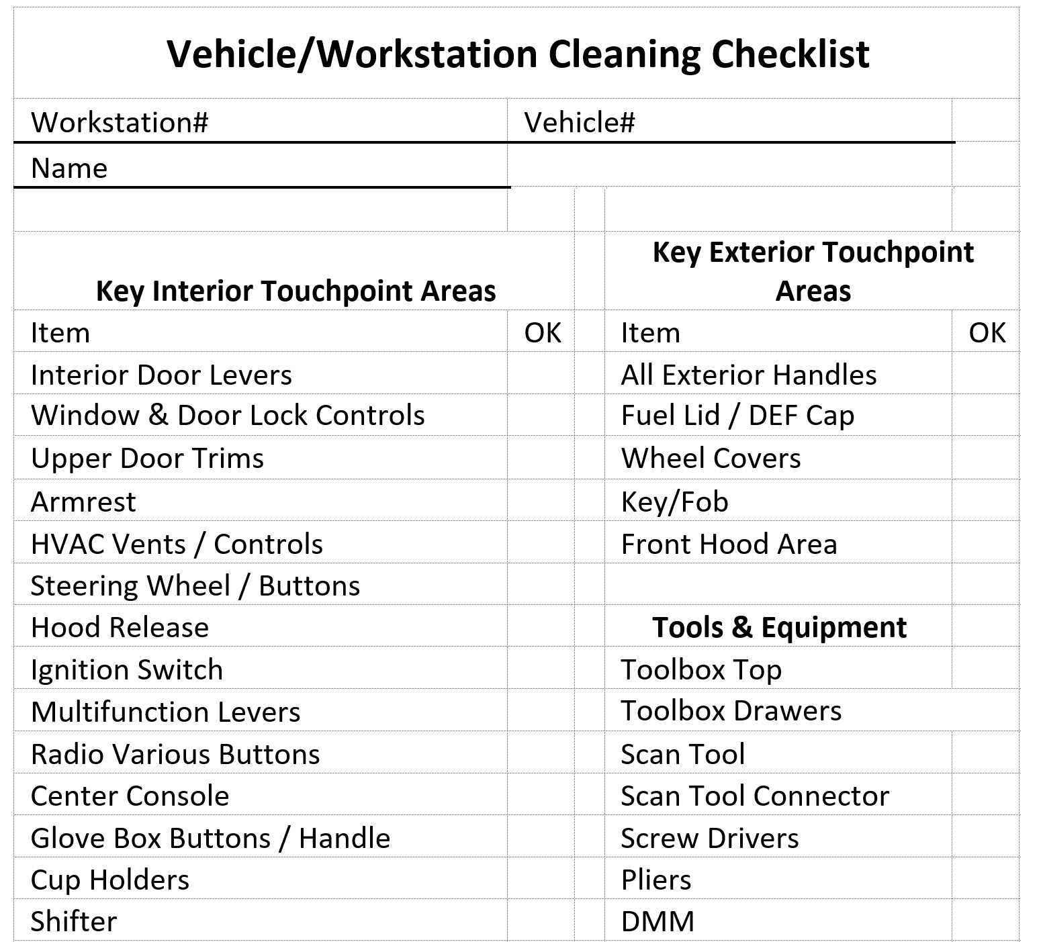
Wiping Down Trucks and Equipment
Use of check list for vehicles and stations

Slide 20
Thank you!
Mariano Rubio
mrubio@citruscollege.edu

